Slide 1
Project Presentation
IOT Based Smart Baby Cradle

Slide 2
Table Of Content
Introduction
Problem Statement
Literature Survey
Proposed Methodology
Requirement Analysis
Architecture
Algorithm Used
GUI Design and Screenshots
Results
Advantages
Conclusion
References

Slide 3
Introduction
Today’s lifestyle is fast paced. Most of the working parents find a bit difficult to manage work along with babysitting. They cannot keep an eye on their child all the time and is hard after long working hours. To sooth the baby by manually swinging the cradle might not be possible in such case. If they have taken help of babysitter for it then also baby’s safety related thoughts keep going in their minds. Hence there is need of product which bridges this gap between parents and baby. This cradle system is proposed to help these parents, so that they can take good care of their baby from remote locations.

Slide 4
Problem Statement
1.
Most of the working parents find a bit difficult to manage work along with babysitting.
2.
We need to develop something unique that can help parents to have continues surveillance on their infants.
Notify the parents via Web, Android Progressive App.
3.

Slide 5
Literature Survey
No. | Name Of Paper | Year Of Publish | Abstract
1. | “General Idea about Smart Baby Cradle” | 2017 | In this research paper author states that system is designed to monitor baby movement.
2. | “An Automatic Monitoring and Swing the Baby Cradle for Infant Care” | 2018 | In this research paper author state that cradle will swing automatically. But proposed system was making too much noise of swing due to which baby was getting disturb from sleeping.
3. | “Development of an Intelligent Cradle for Home and Hospital Use” | 2019 | In this research paper author states that swing mechanism has been provided to the cradle and by reading facial expression.This required AI due to which cost of project increased.

Slide 6
Proposed Methodology
Many of IOT devices are being develop in the IT sector. There are some cradles also, which are built with integration of IOT, but still there are some less features.
Features like just monitoring the baby and auto swing of cradle are in the old system.
We are including these features and also introducing more modern features like Wet Sensing, Temperature Sensing, Automated UV Ray Disinfection,etc.

Slide 7
Requirements
Hardware
Raspberry Pi 3
Temperature Sensor
Camera Sensor
Servo Motor
Sound Sensor
UV Light For Disinfection
Software
OS-Windows 7 & above
Python IDLE 3
Notepad++
Raspbian OS
VS code
Server Drivers
Canva Pro

Slide 8
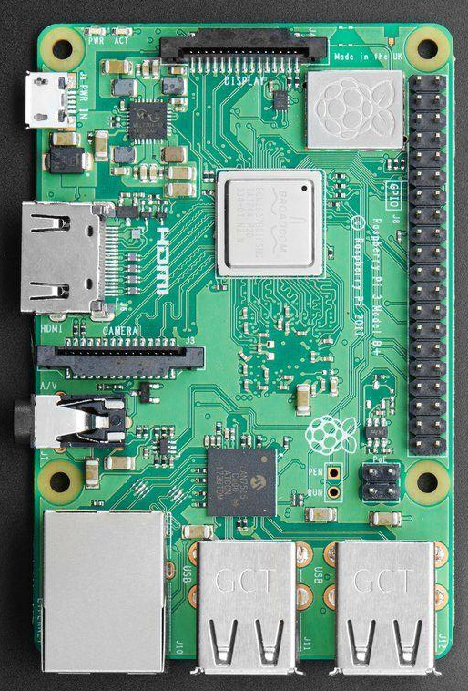
Raspberry Pi 3
The Raspberry Pi 3 Model B is the earliest model of the third-generation Raspberry Pi. It replaced the Raspberry Pi 2 Model B in February 2016. See also the Raspberry Pi 3 Model B+, the latest product in the Raspberry Pi 3 range.
Quad Core 1.2GHz Broadcom BCM2837 64bit CPU
1GB RAM
BCM43438 wireless LAN and Bluetooth Low Energy (BLE) on board
100 Base Ethernet
40-pin extended GPIO
4 USB 2 ports
4 Pole stereo output and composite video port
Full size HDMI
CSI camera port for connecting a Raspberry Pi camera
DSI display port for connecting a Raspberry Pi touchscreen display
Micro SD port for loading your operating system and storing data
Upgraded switched Micro USB power source up to 2.5A

Slide 9
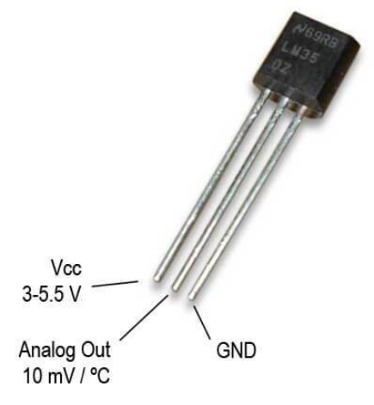
Temperature Sensor
A temperature sensor is an electronic device that measures the temperature of its environment and converts the input data into electronic data to records, monitor, or signal temperature changes.
Low voltage operation (2.7 V to 5.5 V)
Calibrated directly in °C
±2°C accuracy over temperature (typ)
Stable with large capacitive loads
Specified −40°C to +125°C, operation to +150°C
Less than 50 µA quiescent current
Shutdown current 0.5 µA max
Low self-heating

Slide 10
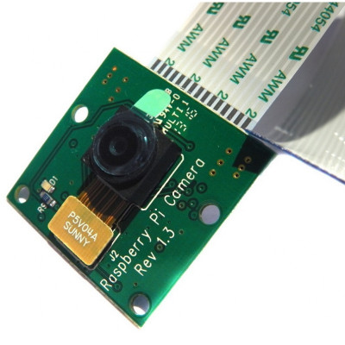
Camera Sensor
This The Raspberry Pi High Definition (HD) Camera Board connects to any Raspberry Pi or Compute Module, allowing you to create HD video and still photographs.
This Sensor Is used for capturing real time image capturing.
It is also used for live video capture from remote place.
This Sensor Identifies weather the baby is in cradle or not and sends relevant signal to the system
Dimensions: 25mm x 20mm x 9mm
5MP resolution
2592 x 1944 pixel static images
1080p30 video
This module is only capable of taking pictures and video, not sound

Slide 11
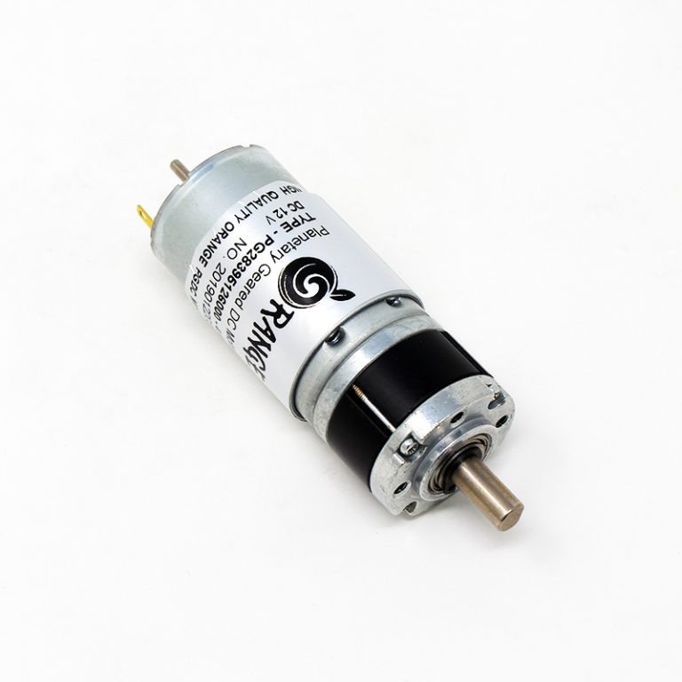
Servo Motor
This work required a low speed D.C. motor working in the range of 6 to 12 volts. The motor chosen should have high torque and specifications as follow:-
• No Load Speed: 78 RPM.
• Rated-Torque: 55 kgf.cm.
• Reduction-ratio: 1/181.
• Direction: CW & CCW.
• Low noise: dB<45.

Slide 12
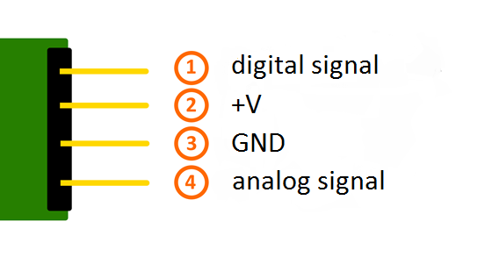
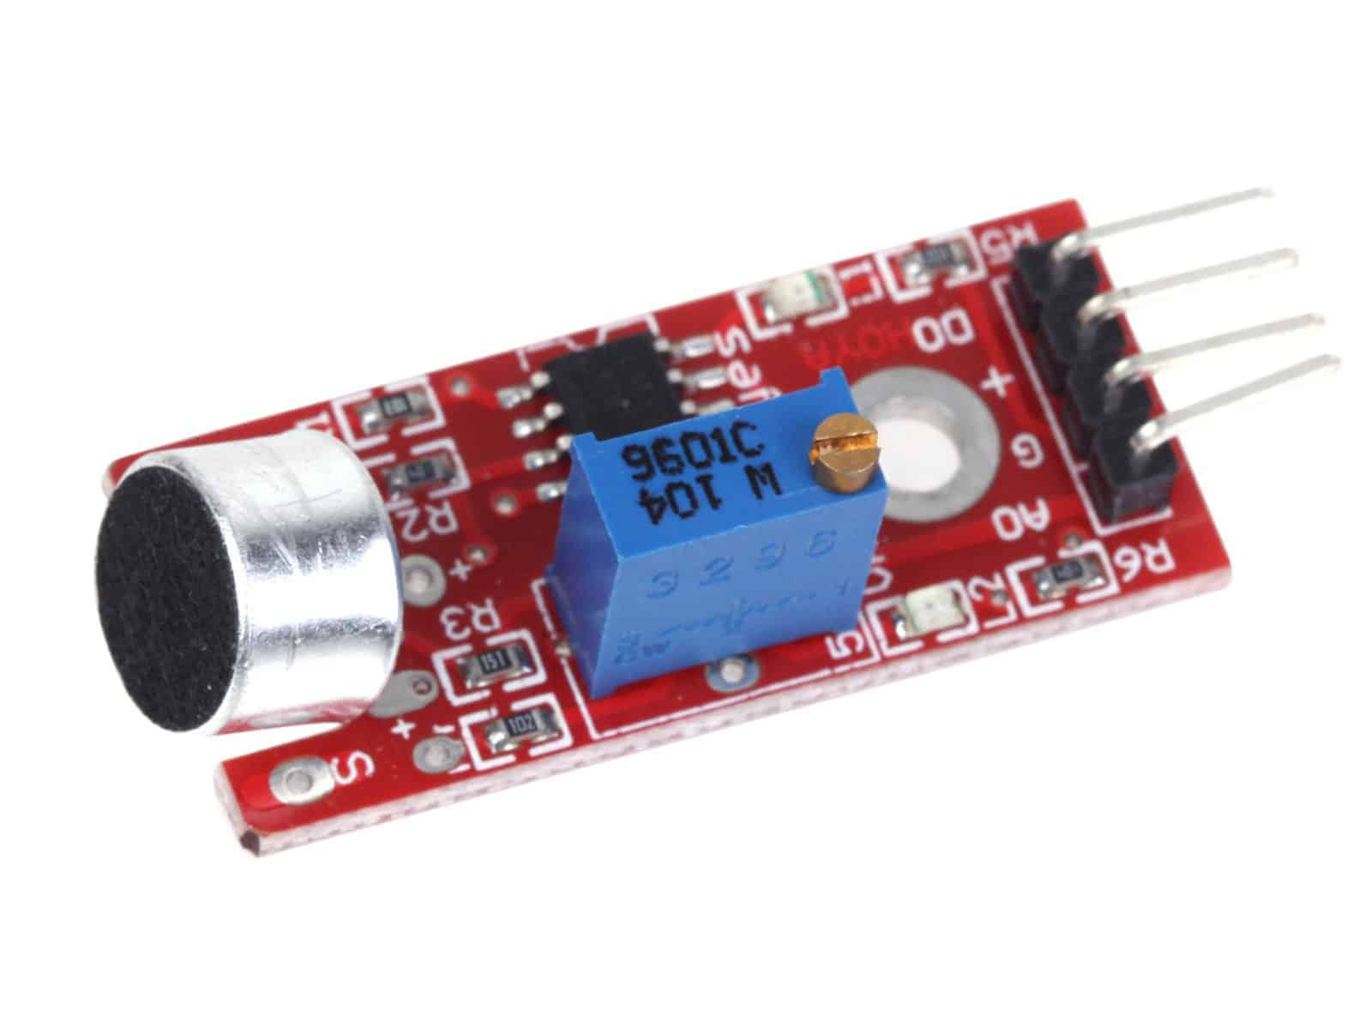
Sound Sensor
The sensor has 3 main components on its circuit board. First, the sensor unit at the front of the module which measures the area physically and sends an analog signal to the second unit, the amplifier. The amplifier amplifies the signal, according to the resistant value of the potentiometer, and sends the signal to the analog output of the module.
The third component is a comparator which switches the digital out and the LED if the signal falls under a specific value. You can control the sensitivity by adjusting the potentiometer.

Slide 13
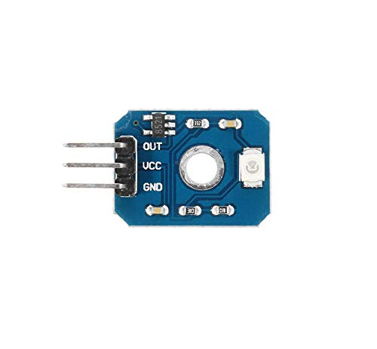
UV Light For Disinfection
The UV light can emit an ultraviolet ray with a wavelength of 253.7nm, which kills the bacterial viruses within a few seconds and the sterilization efficiency is up to 99.99%. Sun rays have Ultraviolet Rays (UV), in range of 100-400nm wavelength in the spectrum. It is divided into UVA, UVB, UVC and UVD.
The two working together can make your home or office building a much healthier place.
Working voltage 3.3V-5V
Output voltage DC 0-1V
Measuring accuracy ±1UV INDEX
Wavelength 200-375nm
Operating temperature -20°-85° , Size 19.8x15mm

Slide 14
System Architecture

Slide 15
Database
UV Light
DC motor
Noise Sensor
User
Cradle
Microcontroller
(Raspberry Pi)
Temp. Sensor
Web Server
Speaker
Web Camera
Wet Sensor

Slide 16
Class Diagram
User
UV Light
Baby Result
Glow Light
Swing Cradle()
Get Scan()
Raspberry Pi
GSM Module
Camera Sensor
Result 1
Result 2
Result 3
Result 4
Information
Video
Sensor Information ()
Get Live Img()
Send Video()
Motor
Wetness Sensor
Result
Get Information ()
Sensor Information ()
Wetness
Constant rotate ()
Get Wetness ()
Send Wetness()
Temperature Sensor
Sound Sensor
Temperature Humidity
Noise
Get Temperature ()
Get Humidity ()
Get Noise()
Send Result()

Slide 17
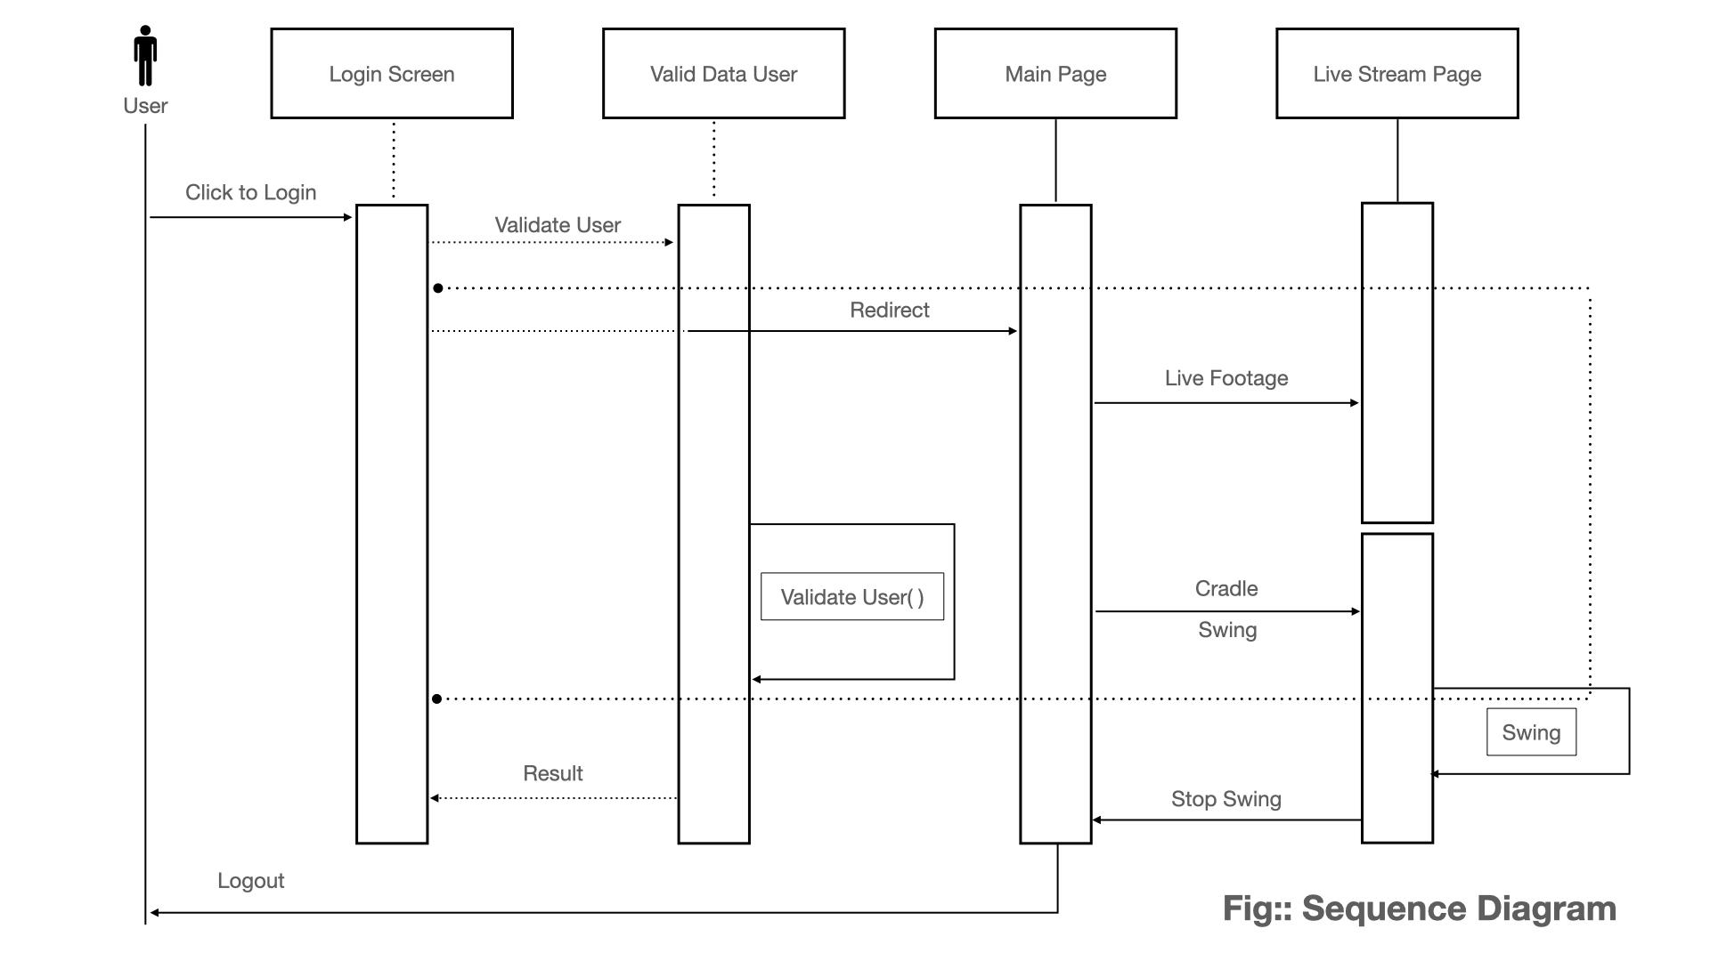
Sequence Diagram

Slide 18
Algorithm Used
To communicate with a PWM driver like the PCA9685, used on Adafruit's 16-channel 12-bit PWM/Servo Driver to interact with the motors attached to the cradle.
Motion Package Algorithm->This is a package that contains everything we need to stream our camera to the Raspberry Pi.

Slide 19
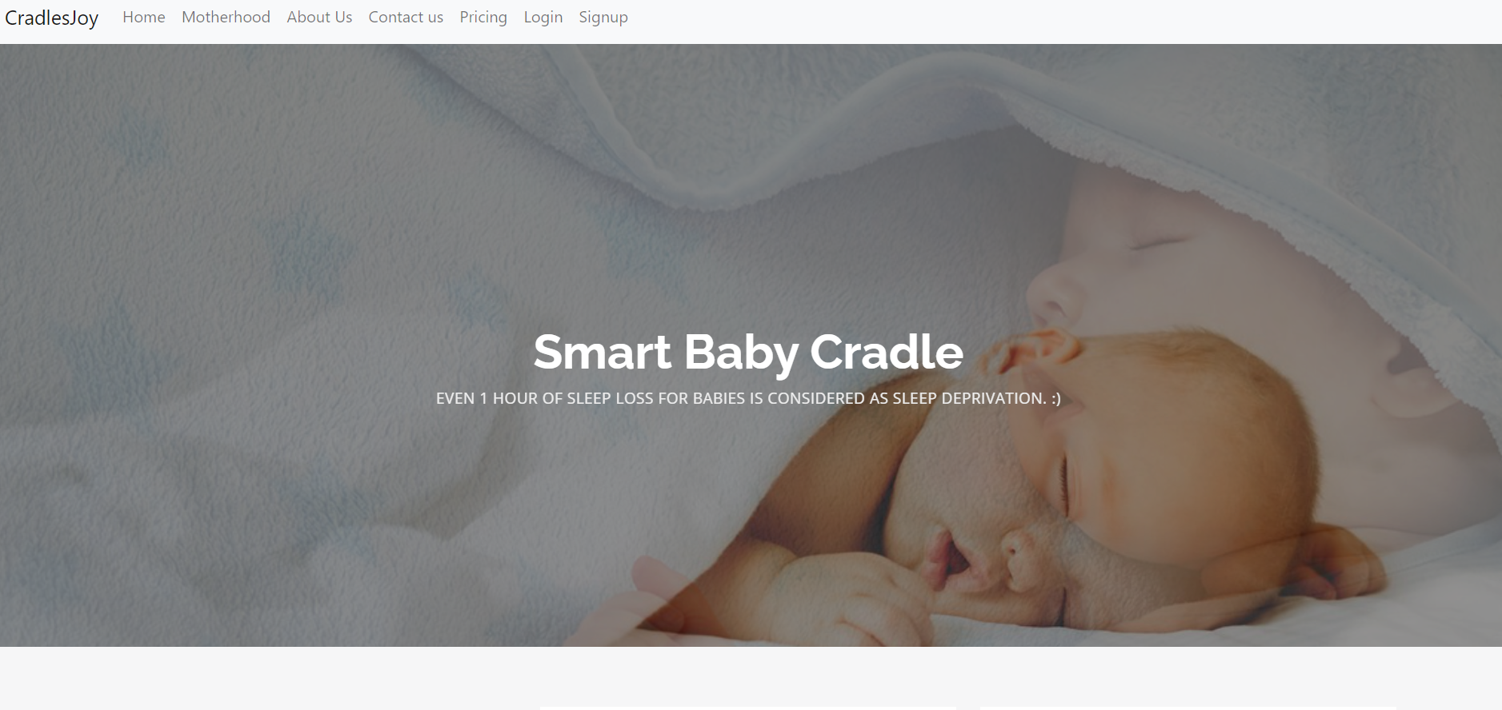
GUI Screenshots

Slide 20
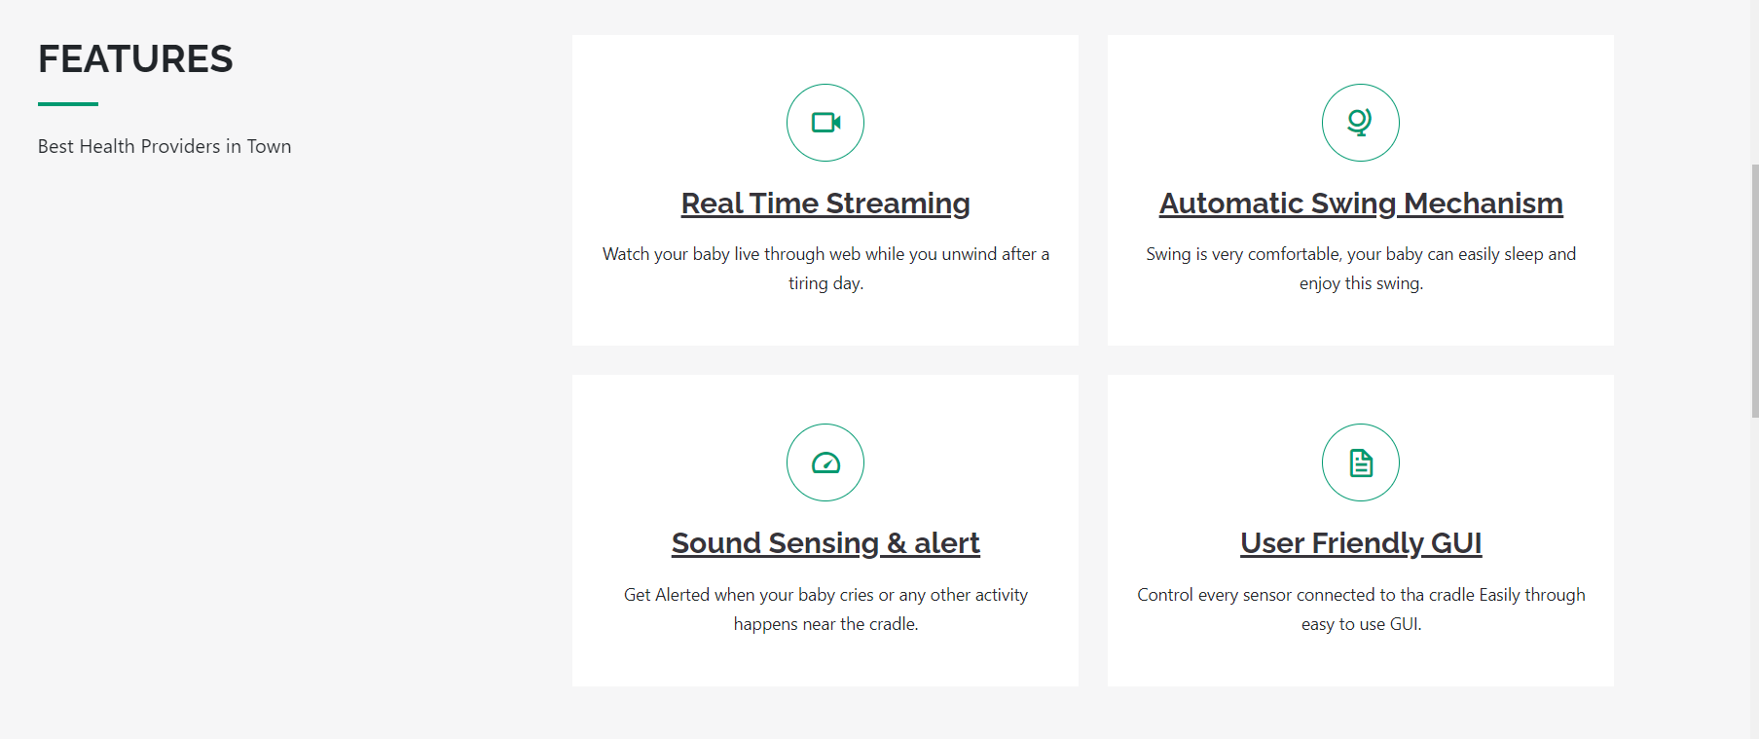
GUI Screenshots

Slide 21
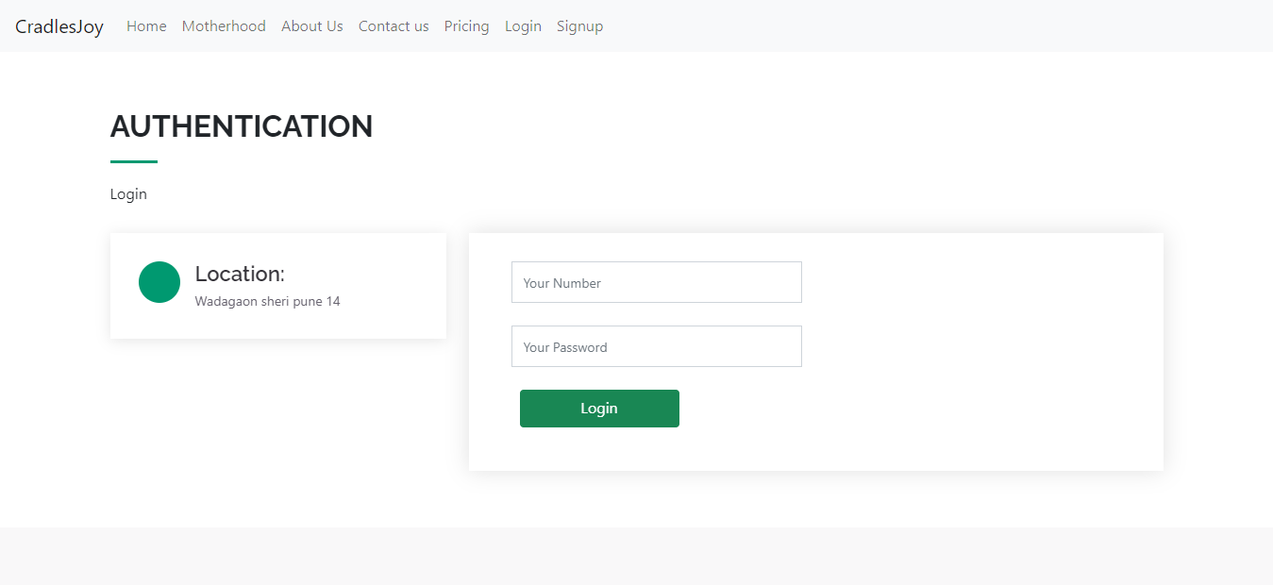
GUI Screenshots

Slide 22
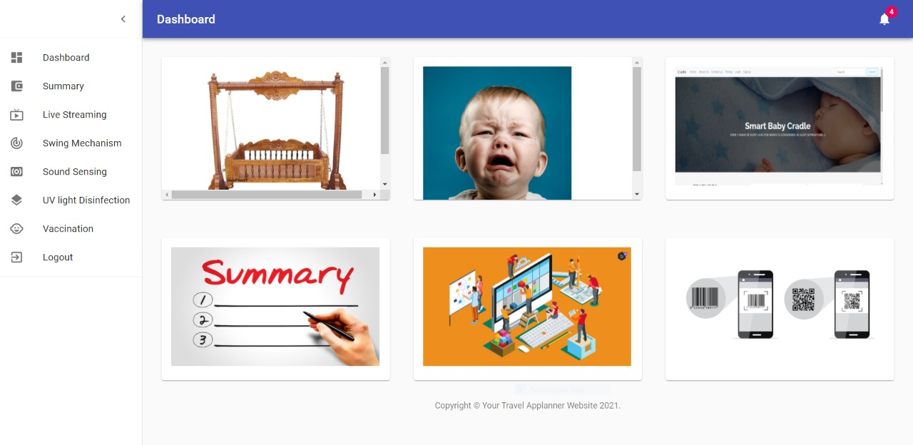
GUI Screenshots

Slide 23
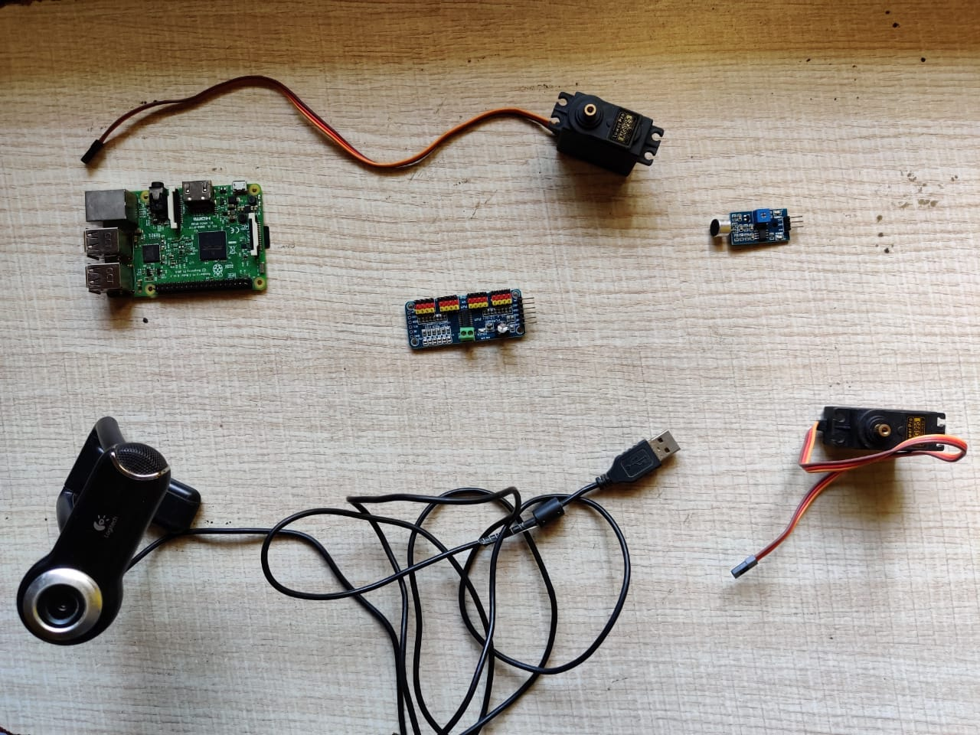

Slide 24
Advantages
Easy for parents to monitor their baby.
Provides security.
Small in size.
Lightweight.
Easy to use.
Cost efficient.
Less power consumption.

Slide 25
Conclusion
This automatic baby cradle would let the working mother to do household works besides taking care of baby at the same time. It is economical and user friendly.
The automatic baby cradle can be used in hospitals and home. It is very useful for working parents and hospitals to take care of babies.

Slide 26
Thank You...

